Slide 1
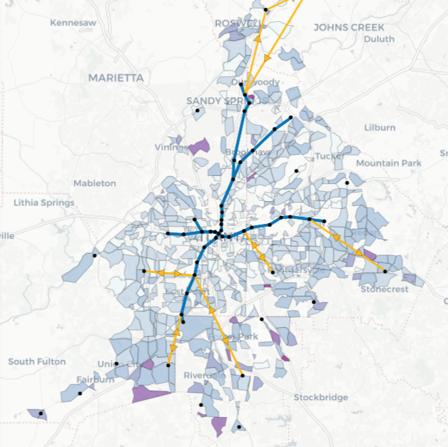
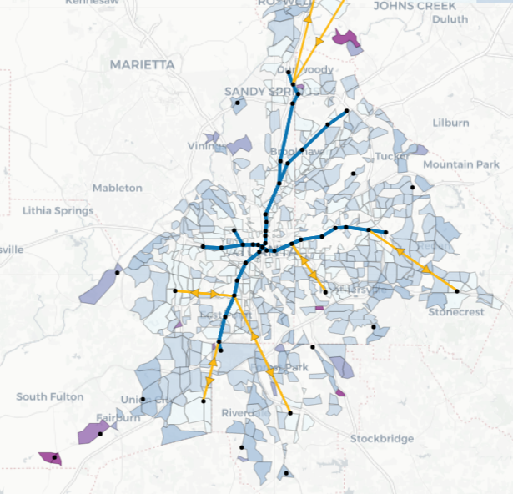
Week 2 Plan
Investigate using passenger specific properties
Current transport cost
Passenger travel time
Number of transfers
Investigate Plan B with fixing part of the network
Reduce computational complexity
Region 1
Region 1

Slide 2
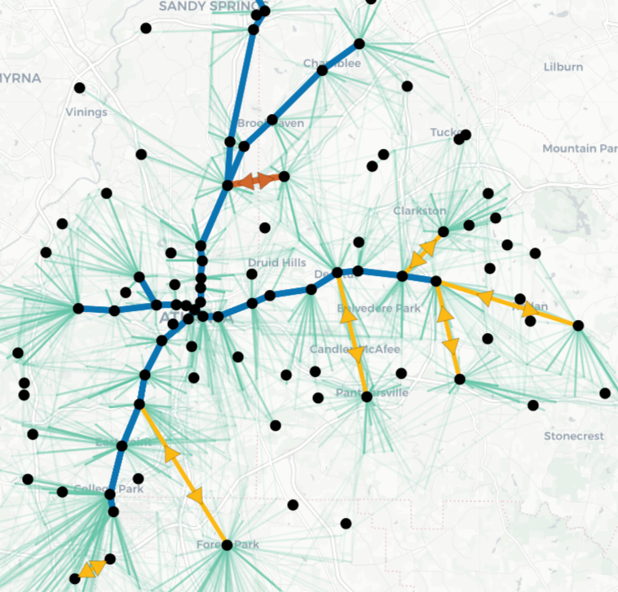
Week 2 Progress
Update potential hub candidates dataset
Get rid of hubs not chosen in the original design
Assign hubs chosen in the original design to a specific region
Re-run design with tuned parameters
travelTimeFactorShuttle = 1.2
travelTimeFactorShuttle = 1.2
alpha = 0.05
mipgap = 0.01
Attempt to fix part of the network (still working on it)
Introducing a hub weight parameter to limit the number of hubs that can be selected from each region
Solve the network design by only considering hubs in a region and its neighbor regions
To-do
Solve runtime issue (takes a long time to generate regional design)
Generate final design
Try other clustering methods

Slide 3
Week 3 & 4 Plan
Starting using large ARC data
Goal: increase the population that utilize public transit system (currently 2%)
Use it for hub selection
Use it to evaluate current network design (on MARTA data)
Generate new O-D pairs to design
Analysis
Current network design
Hub selection
Case study
Specific region
Areas of improvement
Study robustness
Etc.

